Slide 1


Slide 2
Ola Trip Analysis
Data-Driven Insights
Presented by Debasish Panda
Date: July 2025

Slide 3


INTRODUCTION
10000+ Employees work tirelessly to provide you with the best in technology and service
2010 Founded by Bhavesh Aggarwal
7,00,000 Vehicle building mobility for a billion Indians across the country.
250+
Cities serviced by the Ola fleet to get you to your destination on time, every day
10,50,000
Empowered driver-partners operating across 250+ cities for a better tomorrow
3rd
Ranked Startup in India

Slide 4
Business Requirement
Analyze Ola trip data using Power BI to uncover booking trends, revenue, and efficiency.
Support stakeholders in making strategic, data-driven decisions.
Identify optimization opportunities in pricing and service delivery.

Slide 5



Tools & Technologies Used
Power BI – Interactive Dashboards and Visualizations
Excel – Data Preparation and Cleaning
Power Query & DAX – For data modeling, measure creation, and KPI logic

Slide 6
Dashboard 1 – Overview Analysis
KPIs Tracked:
Total Bookings:- 103.7K
Total Booking Value:- ₹1.6M
Average Booking Value:- ₹15.0
Total Trip Distance:- 349K Miles
Average Trip Distance:- 348.93K
Average Trip Time:- 16 Min
Expected Outcomes:
Uncover seasonality or trends in bookings and revenue
Assess trip length and time to monitor service efficiency
Compare patterns over time to support strategic planning

Slide 7
Dashboard 1 – Features
🔘 Measure Selector: Dynamic KPI selection (Bookings, Revenue, Distance)
📝 Dynamic Title: Auto-updated titles based on selected KPI
🧭 Slicers: Filters by City, Date, Trip Type, Payment Type
📊 Vehicle Type Matrix: Conditional formatting, sorting, and comparison of KPIs by vehicle type

Slide 8
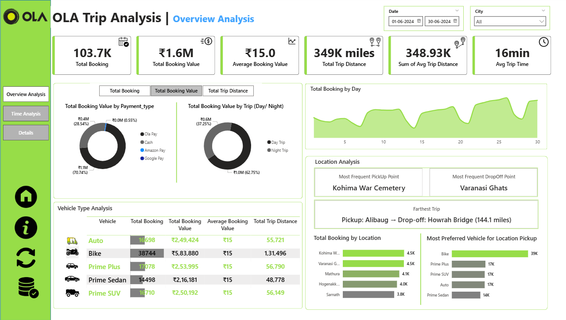

Slide 9
Dashboard 2 – Time-Based Analysis
Visuals Included:
Area Chart: Bookings by 10-minute pickup intervals
Line Chart: Bookings across days of the week (Mon-Sun)
Heatmap: Hour (0–23) vs. Weekday (Mon–Sun)
Purpose:
Identify high/low demand times
Discover weekday vs. weekend patterns
Improve driver scheduling and dynamic pricing

Slide 10
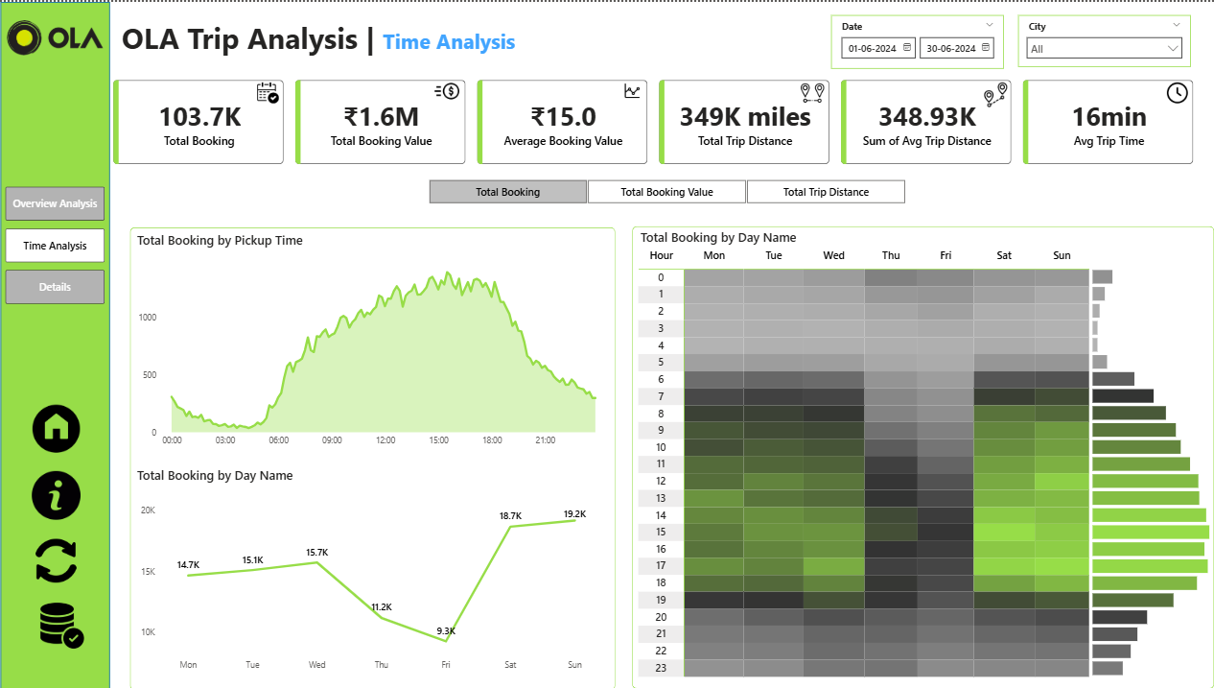

Slide 11
Dashboard 3 – Detail View
📄 Grid Table: Displays granular data such as Trip ID, Pickup Point, Duration, Vehicle Type
🔍 Drill-through Enabled: Access detailed trip records from other visuals
📌 Bookmark Toggle: Switch between full and filtered views for in-depth inspection

Slide 12
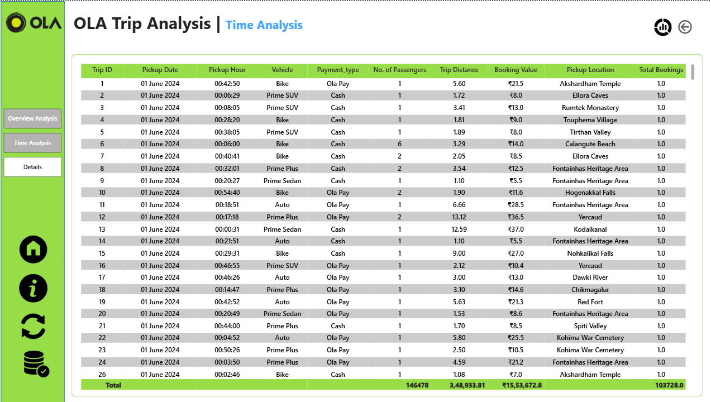

Slide 13
Location-Based Analysis
📍 Most Frequent Pickup/Drop Points: Understand high-traffic zones
🛣 Farthest Trip: Detect long-distance outliers for pricing optimization
🏙 Top 5 Locations by Bookings: Assist in supply-demand balancing
🚗 Preferred Vehicle per Location: Optimize fleet allocation by customer preference

Slide 14
Conclusion
The dashboard delivers comprehensive visibility into Ola’s trip performance
Combines time, location, and revenue insights for strategic business planning
Improves decision-making through interactivity and drill-down features
Supports operational excellence, customer satisfaction, and growth

